Slide 1

NSG Pilkington – University of Liverpool Machine Learning Project: 07/07/2021
Dr. Peter Green
Diego Echeverria
Sarini Jayasinghe
Risk Institute,
School of Engineering

Slide 2
Today
Content:
Predictions with uncertain inputs
Updates on the ISRA-5D processing
Regression using the ISRA-5D data
Upskilling:
Linear regression
How do we learn ‘online’?
What actually is a Neural Network?
What is a Gaussian Process?
How does PCA work?
Shannon Entropy

Slide 3
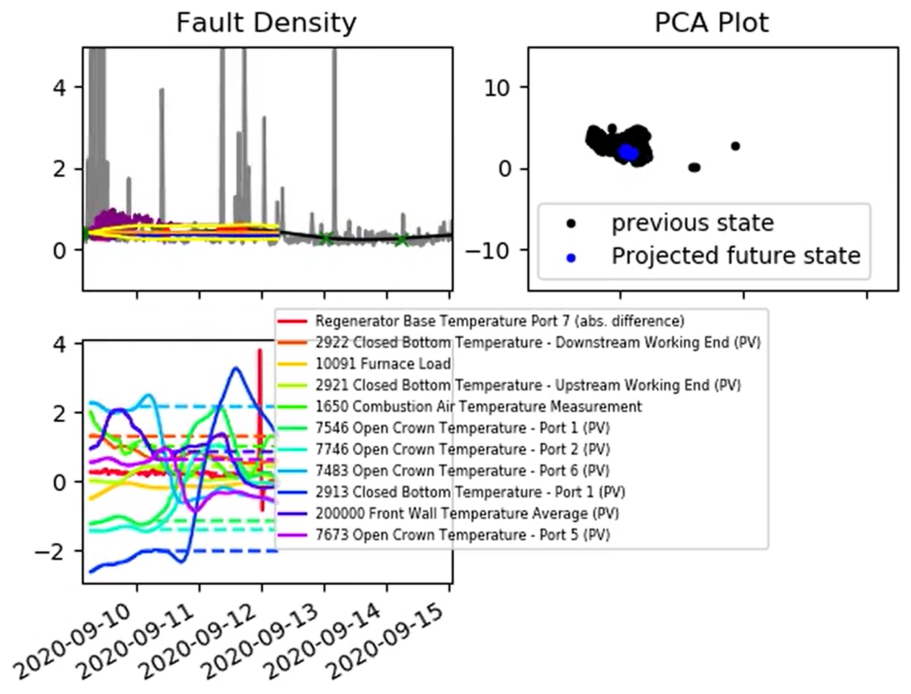
Predictions with Uncertain Inputs
PCA plot now plots the projected inputs, rather than the true model inputs.
9400 Port 2 Gas Flow (SP) is now included as a ‘known input’, though the GP hasn’t yet identified it as an important input.
Time lag for the average front wall temperature now set equal to 24 hours.
Interestingly, it still consistently appears as an important model input for the GP.
These results are in ‘2021-07-01_results.mp4’ on the sharepoint.

Slide 4
Predictions with Uncertain Inputs
For now, this plot still shows the projected and the true model inputs – we might need this information for the deep dive review?
We could experiment with plotting the true model inputs with a semi-transparent line (or just removing them completely) if that helps.

Slide 5
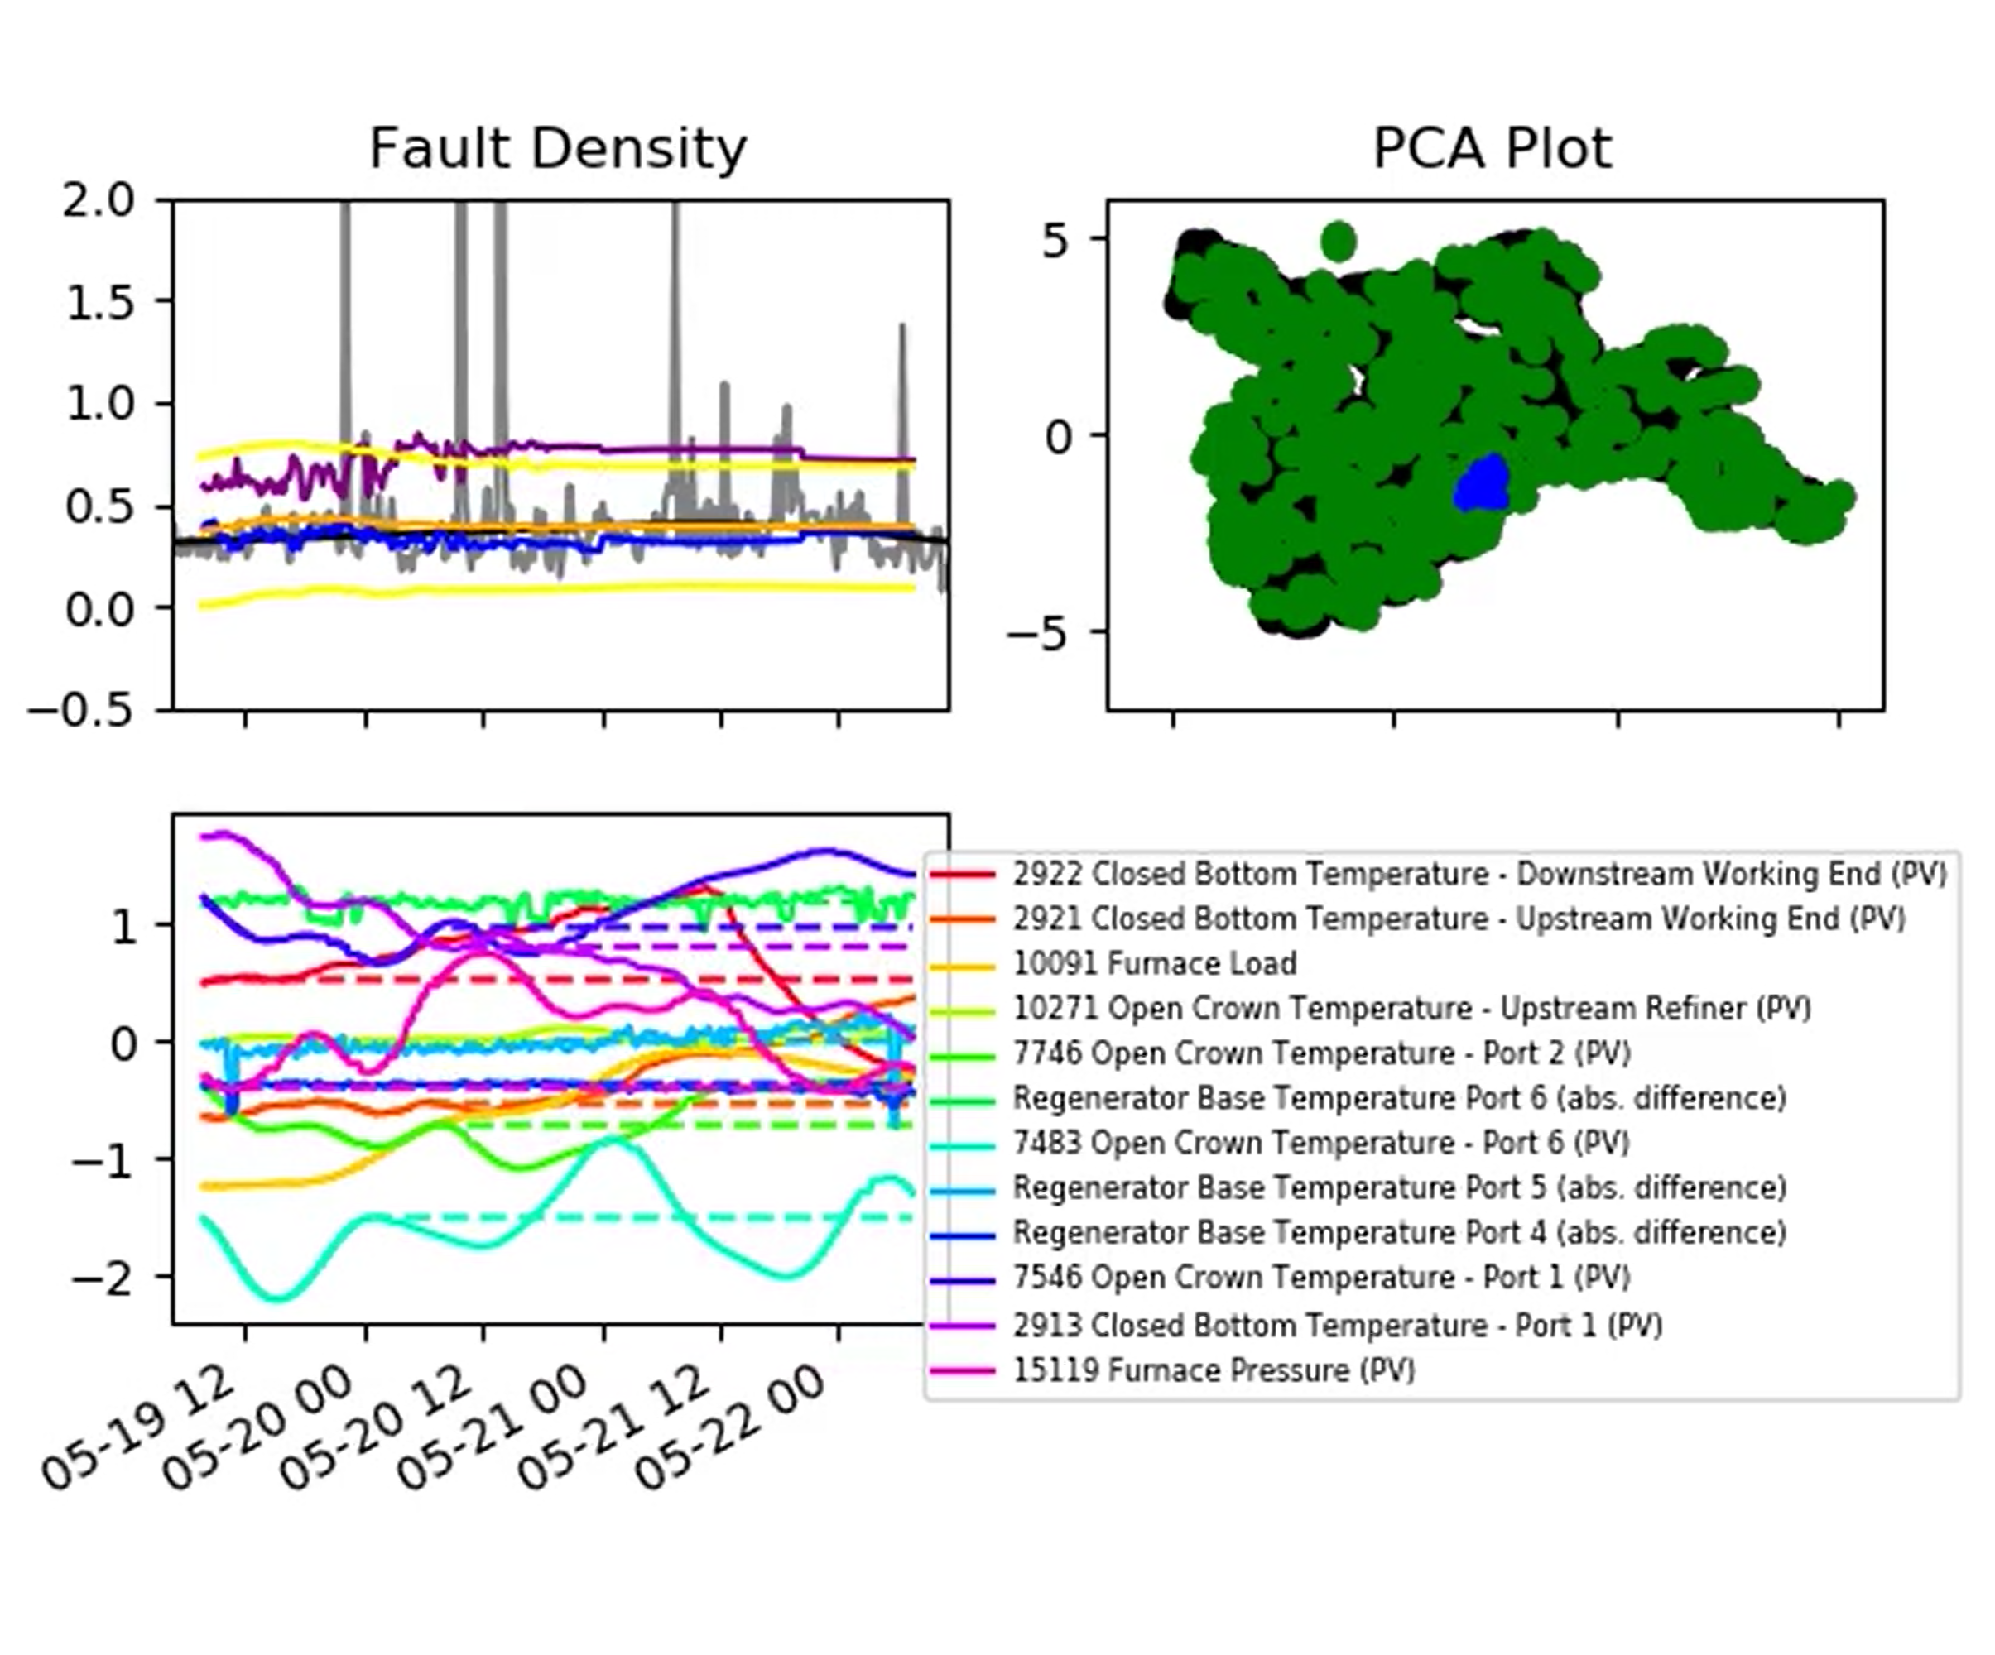
Predictions with Uncertain Inputs
GP performance on the test data (i.e. May 2021) is generally good, but does depend on the training data that we use.
As we suspected, the list of important inputs also depends, to some extent, on the training data.
I think this simply illustrates the need for a single ‘large’ training run that we can conduct towards the end of this phase of the project.
These results are in ‘2021-07-01_test_results.mp4’ on the sharepoint.

Slide 6
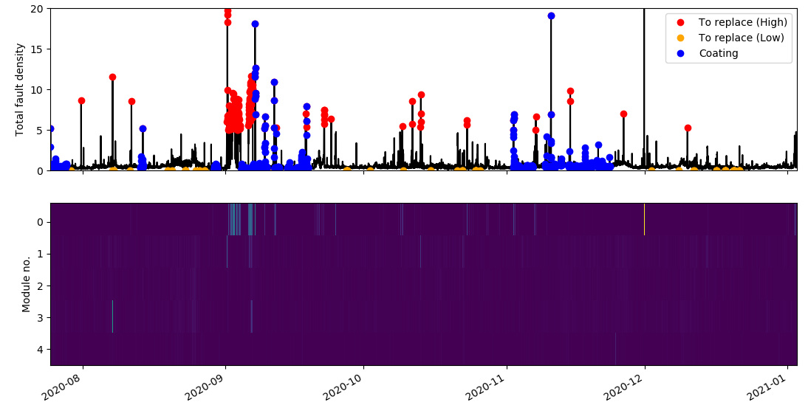
ISRA 5D
Identified points to ignore do not match with coating periods identified using campaign data description ID

Slide 7
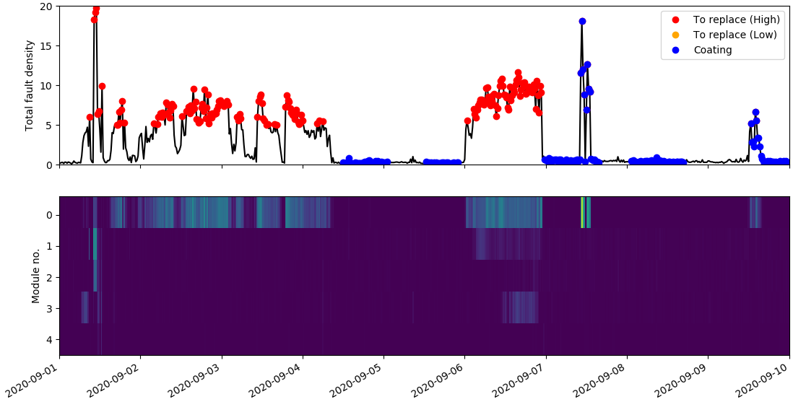
ISRA 5D

Slide 8
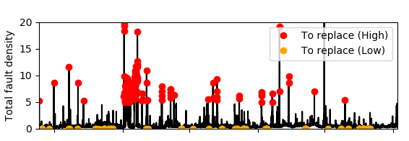
Data Processing Pipeline (ISRA-5D)
Isolate raw data between specified time period
0
Process fault density
1
Identify high furnace fault (ff > 5) and low furnace fault (ff < 0.05) values
Replace offending module data with the average of remaining modules at identified high fault density values
Replace low values with the previous reading

Slide 9
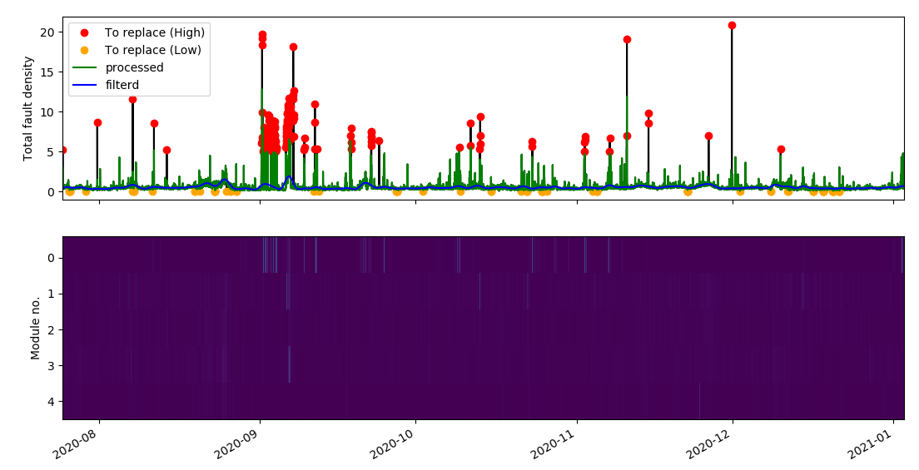
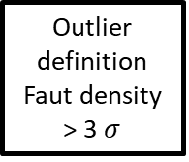
Data Processing Pipeline (ISRA-5D)
Remove spikes
0
Low pass filter
1
High pass filter
Outlier definition
Faut density > 3 $σ$
Remove outliers

Slide 10
ISRA 5D
Total number of points = 11663
Number of high values processed = 217 Percentage = 1.86 %
Number of low values processed = 87 Percentage = 0.74 %
Number of processed elements = 304 Percentage = 2.60 %

Slide 11
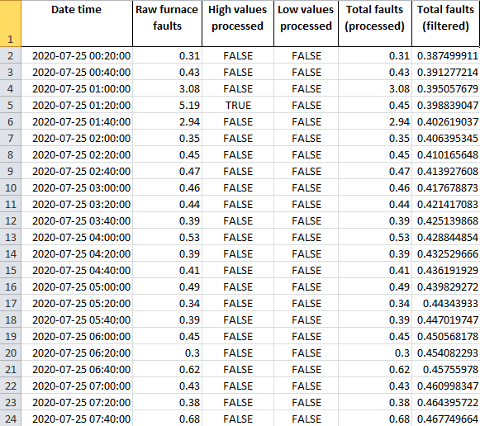
ISRA 5D
Excel file `Total furnace faults (ISRA)’ uploaded to sharepoint

Slide 12
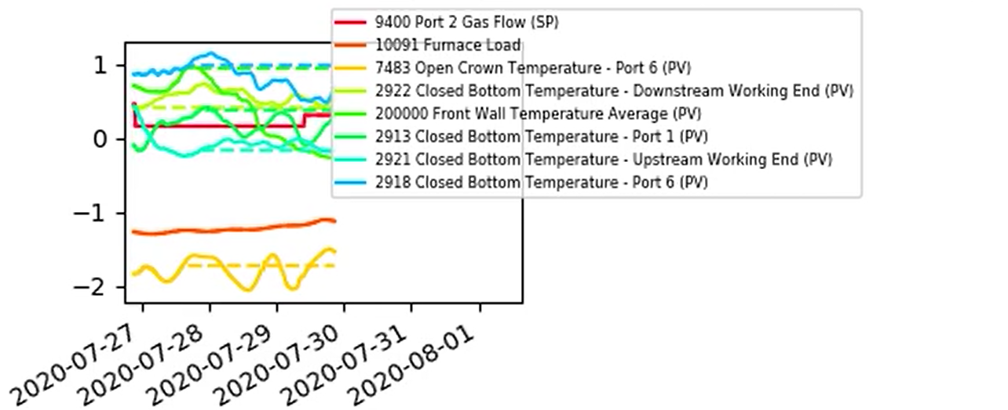
ISRA-5D: Predictions with Uncertain Inputs
Using the threshold value: Hyperparameters < 10 (While smaller the hyperparameter, the more relevant the input is)
The GP has identified 8 relevant inputs

Slide 13
ISRA-5D: Predictions with Uncertain Inputs
9400 Port 2 Gas Flow (SP) identified as relevant Front Wall Temperature Average
Identified as relevant

Slide 14
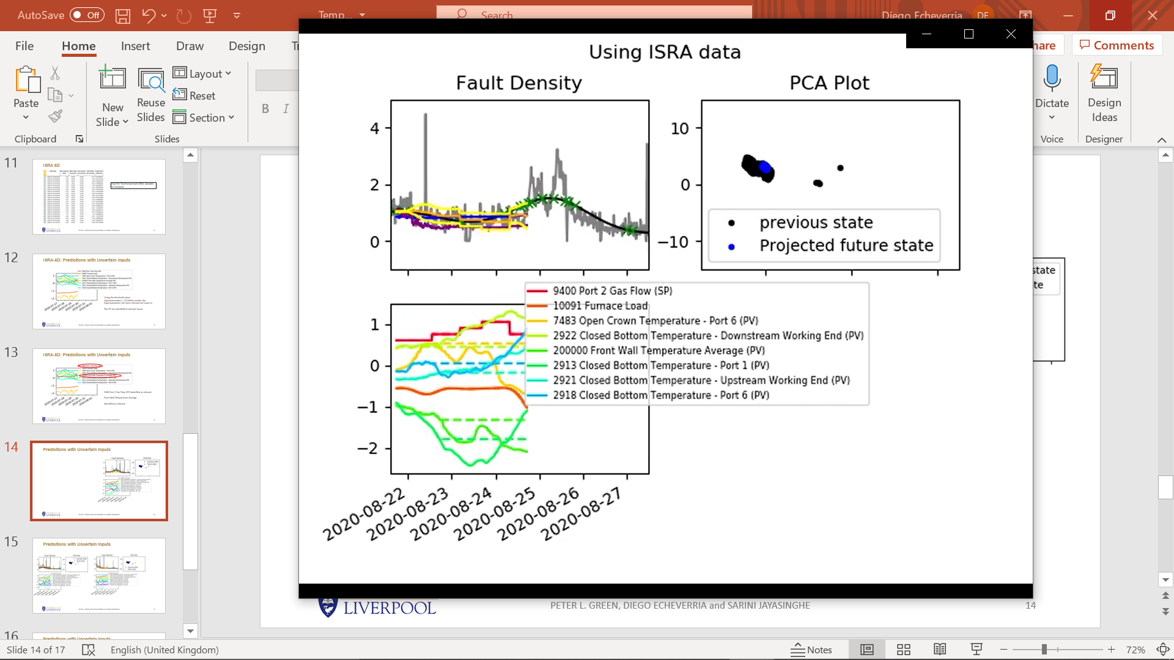
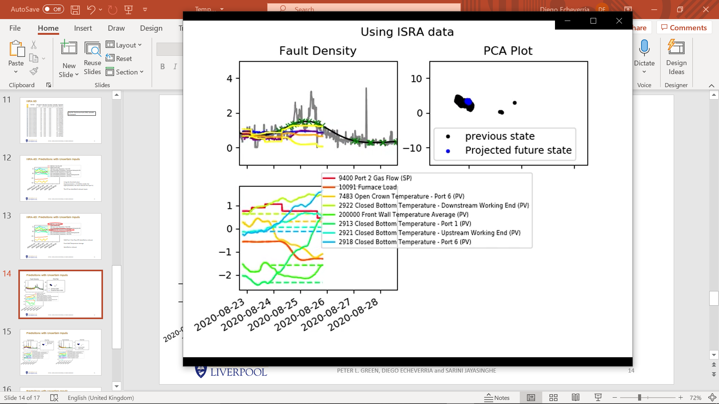
Predictions with Uncertain Inputs

Slide 15
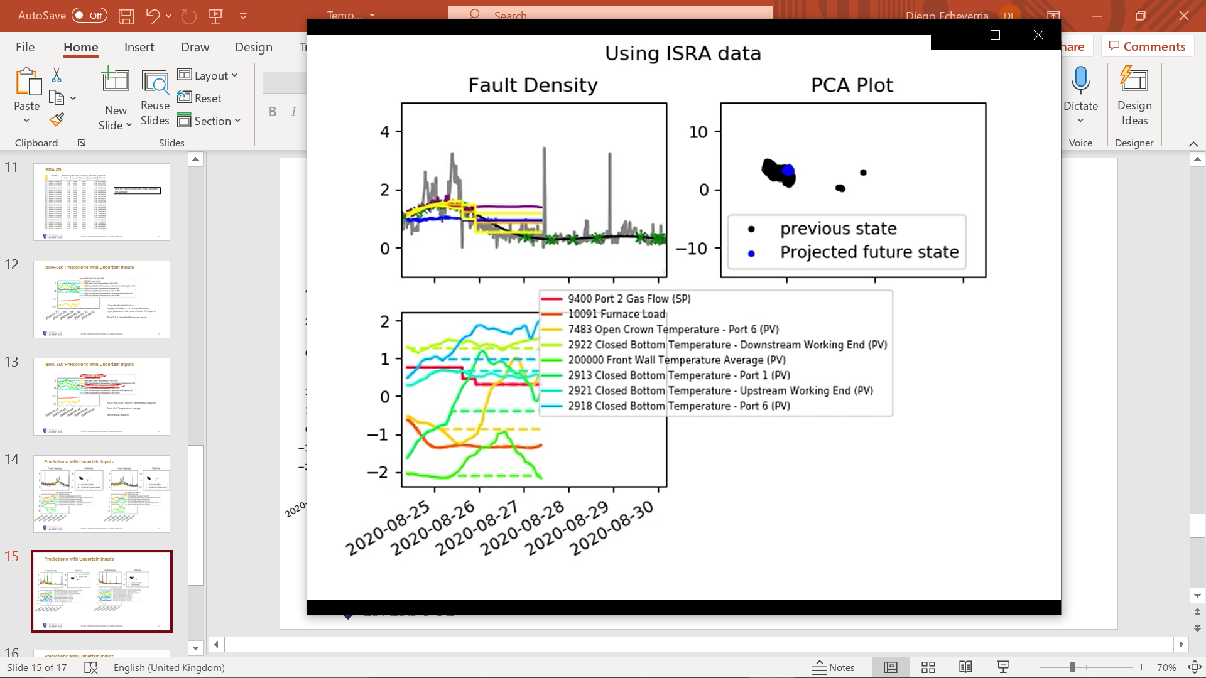
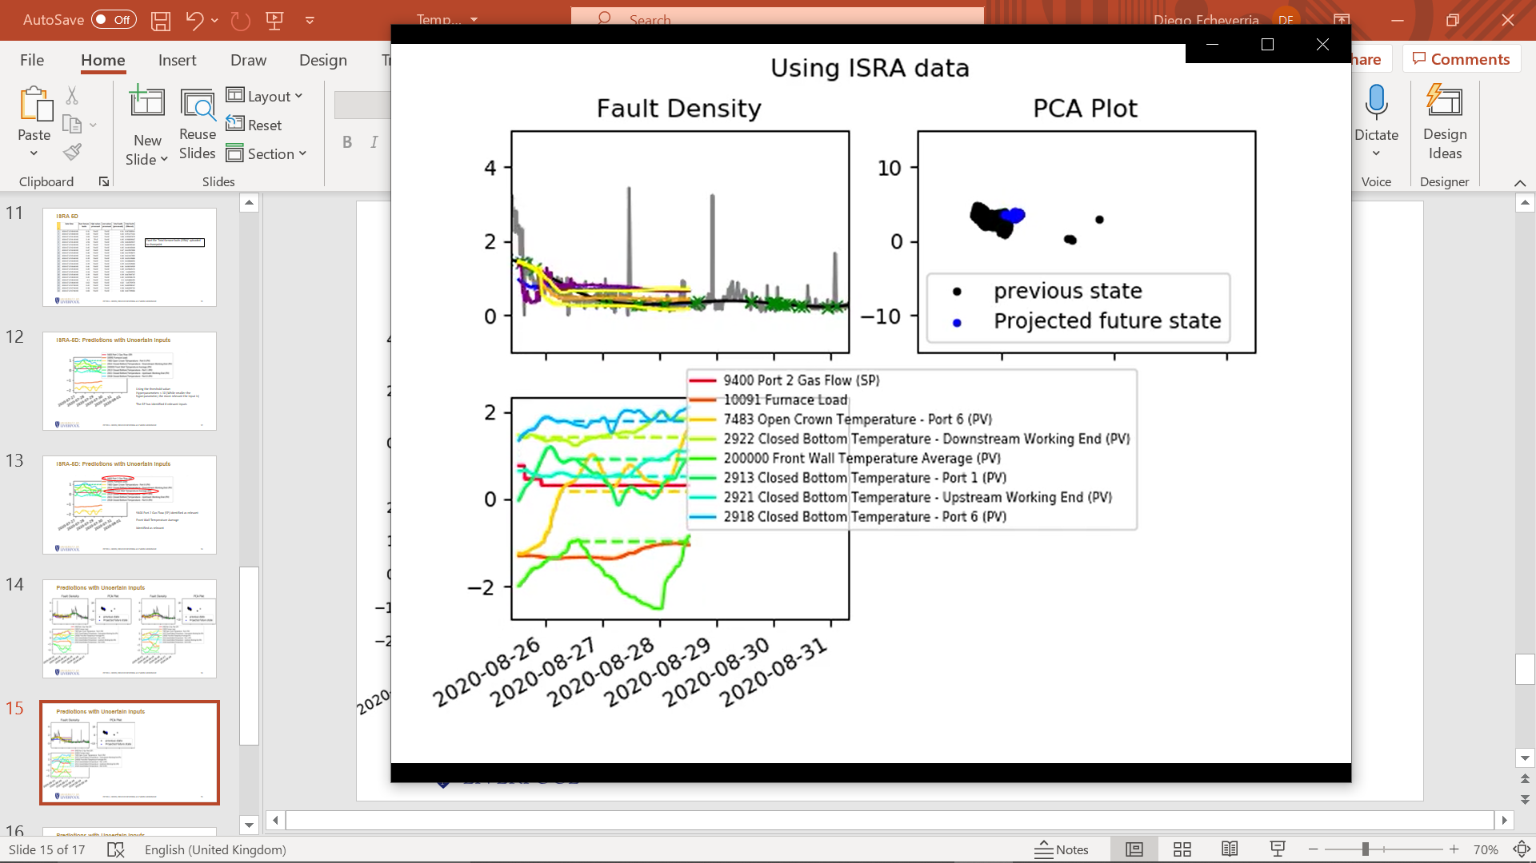
Predictions with Uncertain Inputs

Slide 16
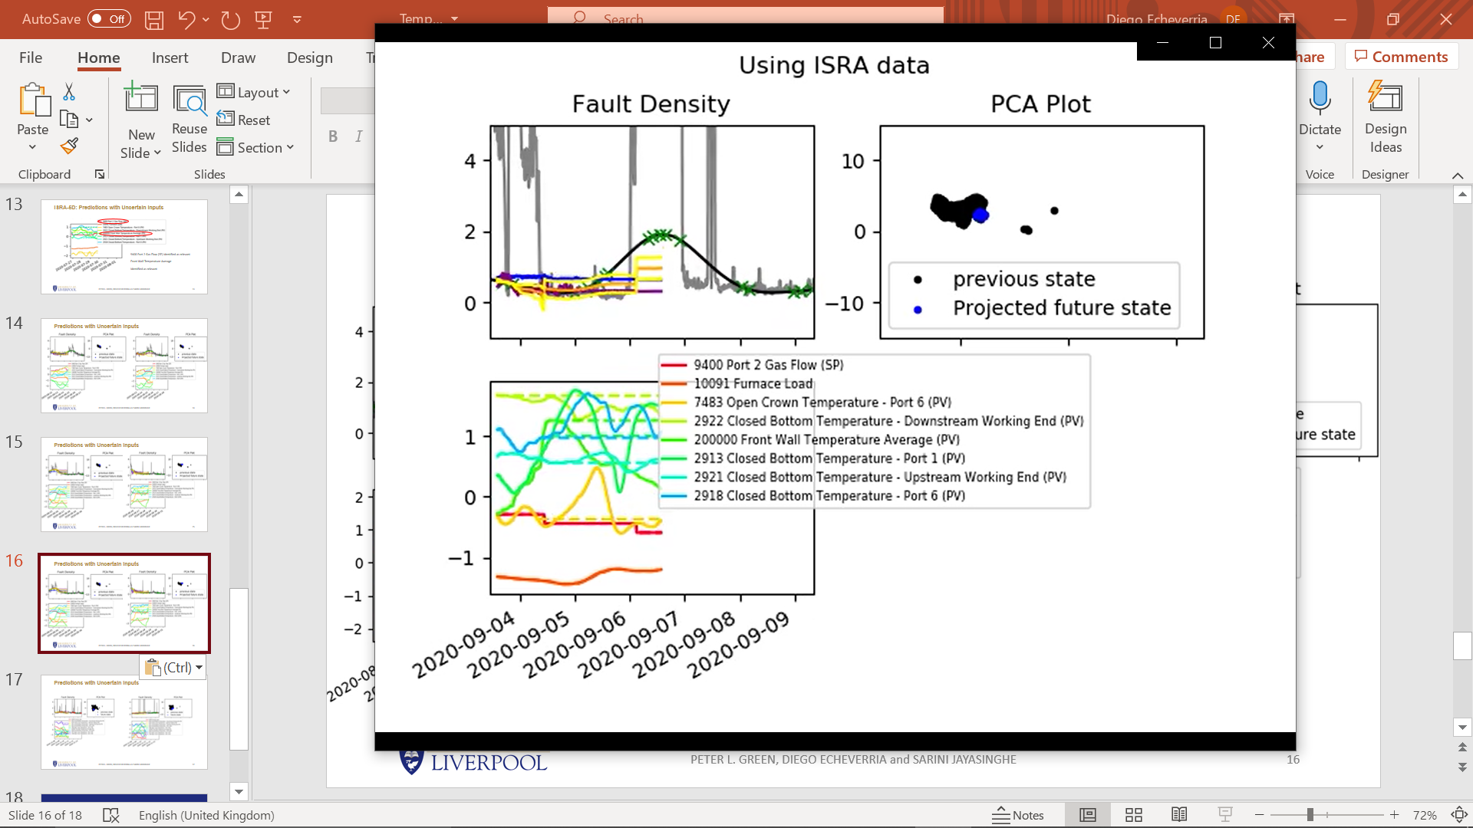
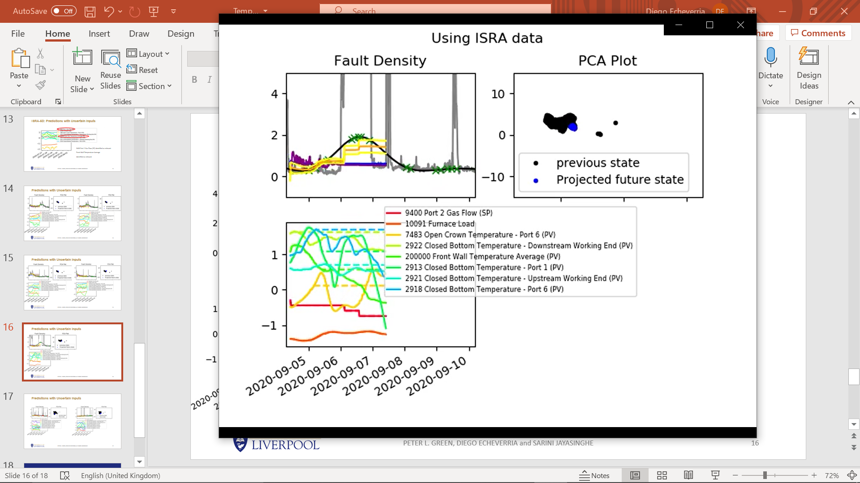
Predictions with Uncertain Inputs

Slide 17
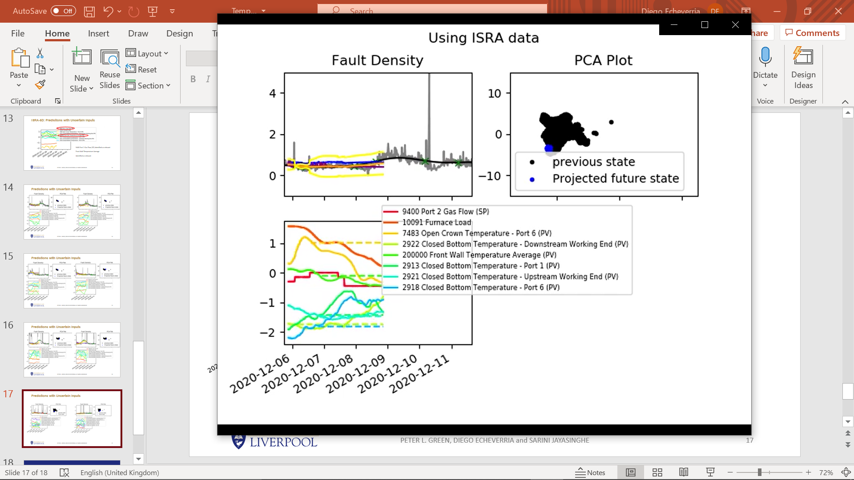
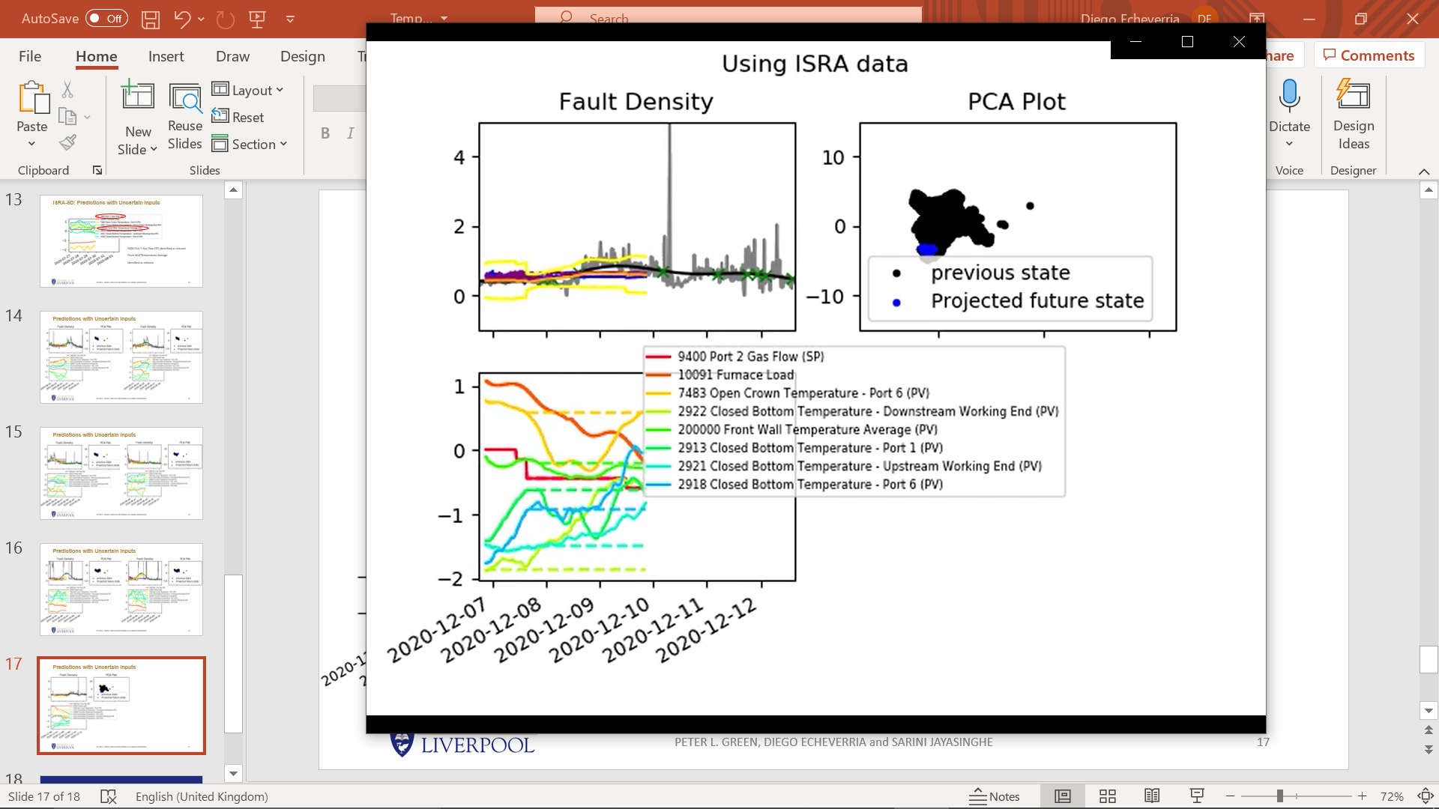
Predictions with Uncertain Inputs

Slide 18
Next Steps
Regression on the test data using the ISRA-5D fault density.
Identify an ultimate list of relevant inputs:
We might have memory issues if a larger set of training points is used.
Using the current number of training points and many simulations.
Run the models using only the relevant inputs and see if we experience any improvements on the test data.
Long term
Furnace AI report
Upskilling

Slide 19
Thank you for your attention. ANY QUESTIONS?

